Slide 1

Predicting MetaScores
of Video Games
By: Ana Maharjan, Nicole Nguyen, Shaun Tan, Leo Liu, Unii Saikhanbileg

Slide 2
Gaming Industry
$89 Billion USD (2019)
Forecasted Growth of 3.6% between 2015-2020 (Statista)
7,672 games were released on Steam in 2017
Notes:
Stats from: https://www.statista.com/statistics/292056/video-game-market-value-worldwide/

Slide 3


Metacritic
Aggregate of world’s most respected critics who assign scores to their reviews
Apply a weighted average to summarize the range of their opinions.
Range of 1 - 100

Slide 4
Agenda
Overview of Dataset
Data Pre-Processing Steps
Predictive Modeling Methods
Further Exploration
Conclusion

Slide 5
Our Dataset
2,225 Records
43 Predictors
1 Target Variable: Metacritic
13,357 Records
78 Variables
Released in 2016
Raw Dataset
Final Dataset
Notes:
Which year is our data set from??? ***
Size of Data set (number of records, number of predictors
Different genre of games> metacritic
Supported Languages> Size by Query
Free/ vs non free games?

Slide 6
Data Pre-Processing

Slide 7
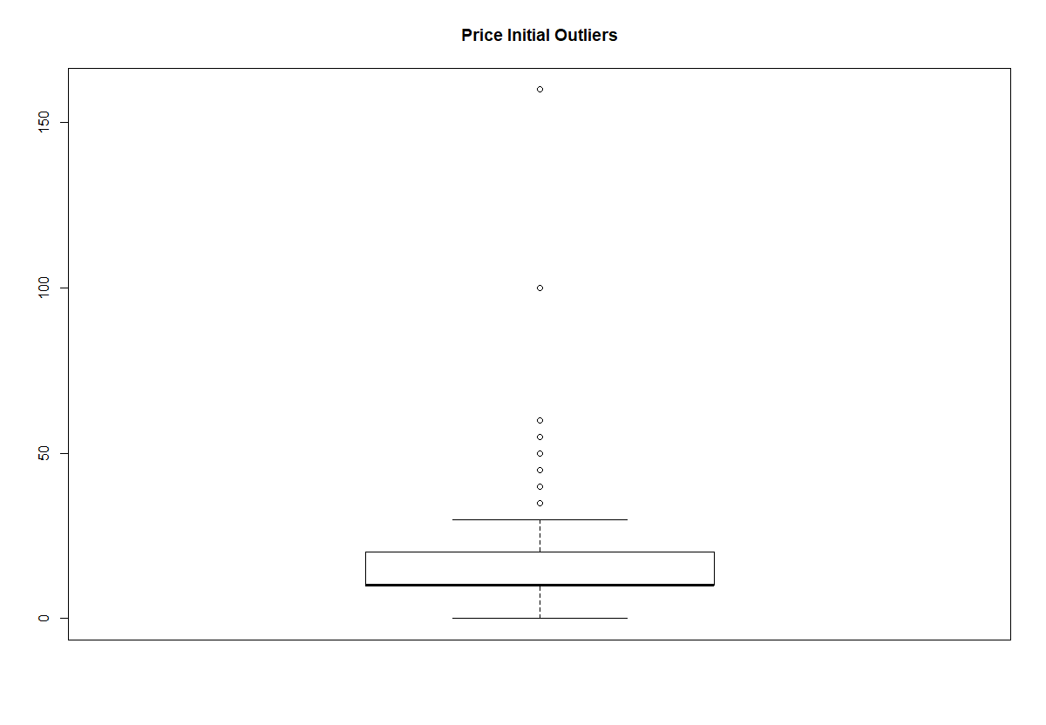
Data Pre-Processing
Check for Missing Values
Remove Irrelevant Columns
Remove Values Under 0 for Metacritic
Remove Repeated Rows for QueryID
Check for and Remove Outliers
Notes:
Got rid of varialbes that have “true” for everything because it wouldn’t influence the results> Also because we kept getting an error message that there needs to be 2 or more levels for it to work

Slide 8
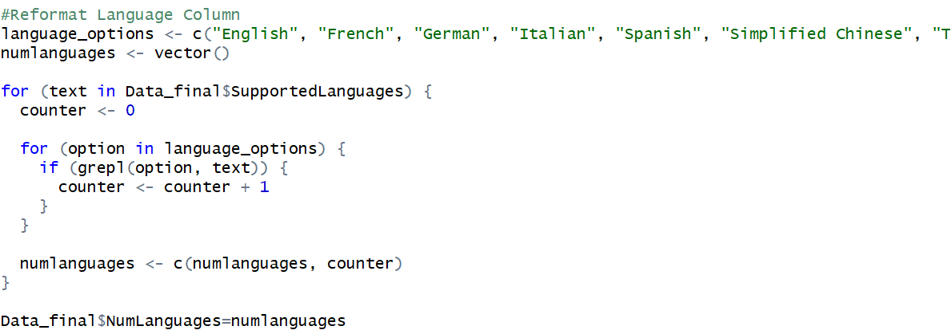
Data Pre-Processing
Reformat Language Column
As.factor
Data_final[,14] = as.factor(ifelse(Data_final[,14]=="True",1,0))

Slide 9
Data Dictionary
RequiredAge, RecommendationCount, DeveloperCount, DemoCount, LanguageSupport
Numeric
Indie, Action, Strategy, RPG, Casual, Adventure, Racing, Simulation
VR Support, InAppPurchase, Multiplayer, Singleplayer
Genre
Metascore
Category
Subscription, Purchase, Free, ControllerSupport
Mac, Linux, PC, ReqsHaveMin, ReqsHaveRec
Availability
Platforms
See Appendix A1-A3 for entire dictionary

Slide 10
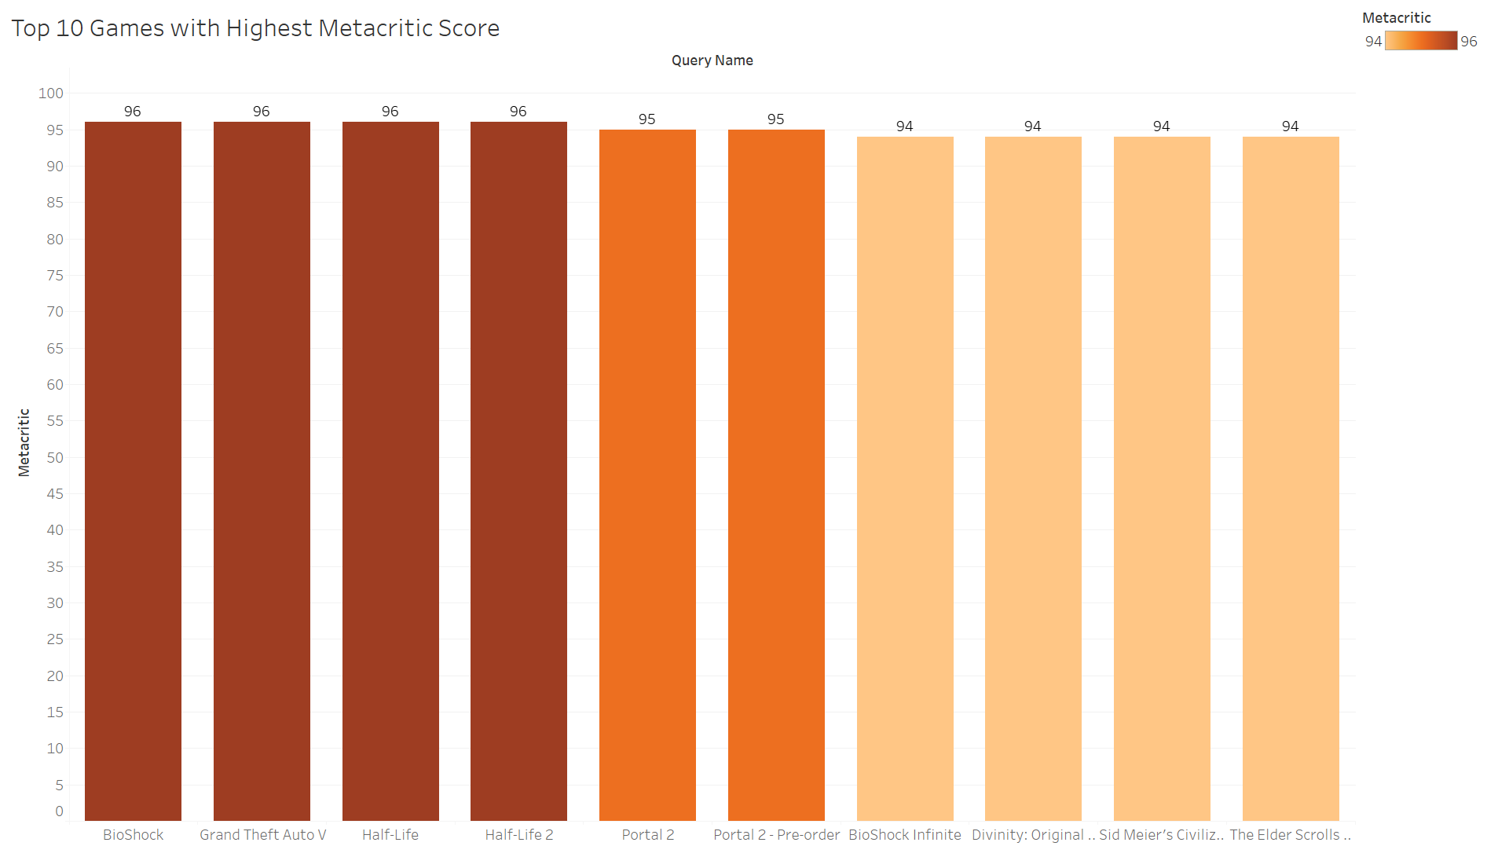




Action
Action
Action
Action
Action
Action
Action
Action
Indie
Adventure
Strategy
RPG
RPG
RPG

Slide 11
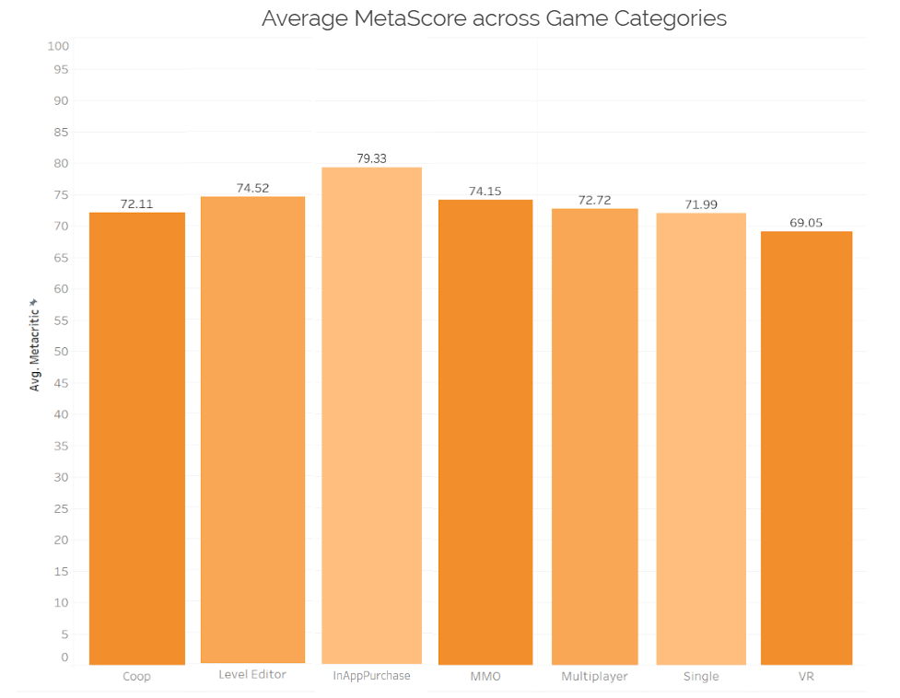

Slide 12
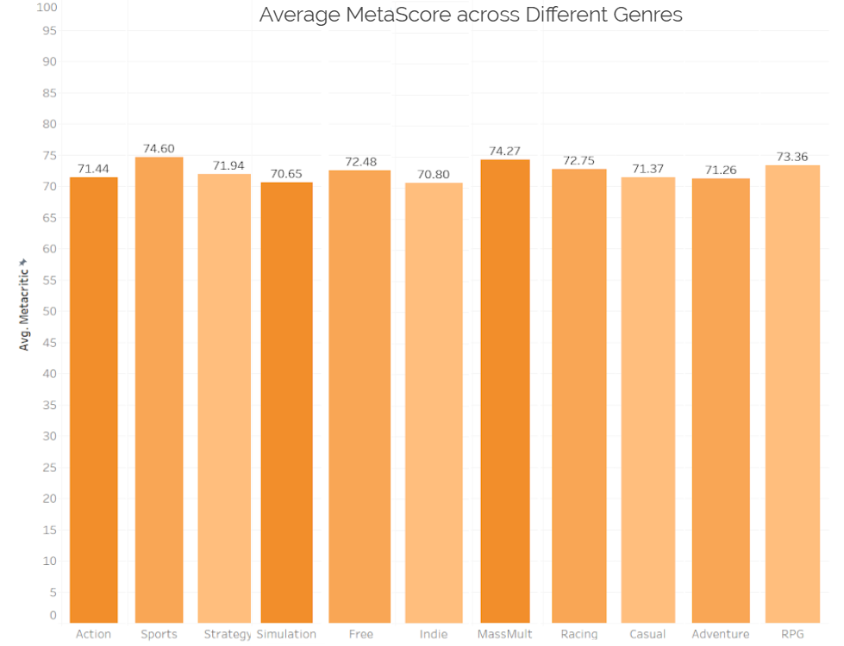

Slide 13
Predictive Modeling Methods

Slide 14
Linear
Regression
Regression Tree
kNN
Regression
Set Seed: 1, 212, 123, 413, 1234
Training 80% - - Validation 20%

Slide 15
Linear Regression

Slide 16
Linear Regression Steps
1
Checking Significance of Categorical Variables
1
Create Models: Base, Forward, Backward, Stepwise
2
2
3
Predict with Validation Dataset
3
Compare Accuracies
of Models
4
4
See Appendix

Slide 17
Accuracy Measures
set.seed(413) | RMSE Root Mean Squared Error | MAE Mean Absolute Error
Base Model | 9.957493 | 7.659212
Forward Selection | 9.878002 | 7.590239
Backward Selection | 9.972383 | 7.679073
Stepwise Selection | 9.972383 | 7.679073

Slide 18
Forward Selection Method
Positive |  | Negative
CategoryMMO | 4.821 | PCReqsHaveRec | -3.057
CategorySinglePlayer | 3.914 | CategoryCoop | -2.001
CategoryIncludeLevelEditor | 2.906 | GenreIsSimulation | -1.684
GenreIsSports | 2.740 | GenreIsIndie | -1.614
PlatformMac | 2.271 | GenreIsAction | -1.419
GenreIsRPG | 1.668
MacsReqsHaveRec | 1.413
Package Count | 1.083
PriceInitial | .0134
RequiredAge | .0103

Slide 19
kNN Regression

Slide 20
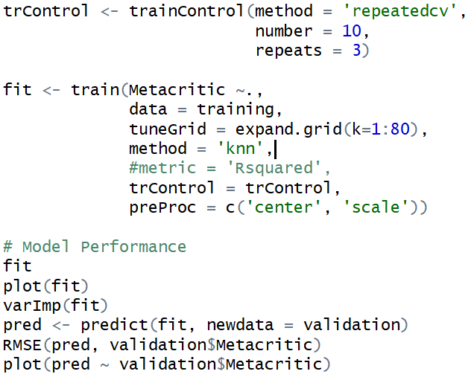
kNN Regression Steps
Load package “caret”
Convert all variables to numeric
Do 10-fold cross validation
Repeat 3 times

Slide 21
kNN Regression Steps
Load package “caret”
Convert all variables to numeric
Do 10-fold cross validation
Repeat 3 times

Slide 22
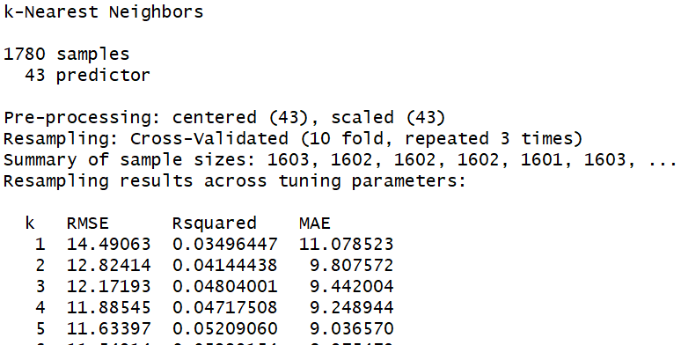
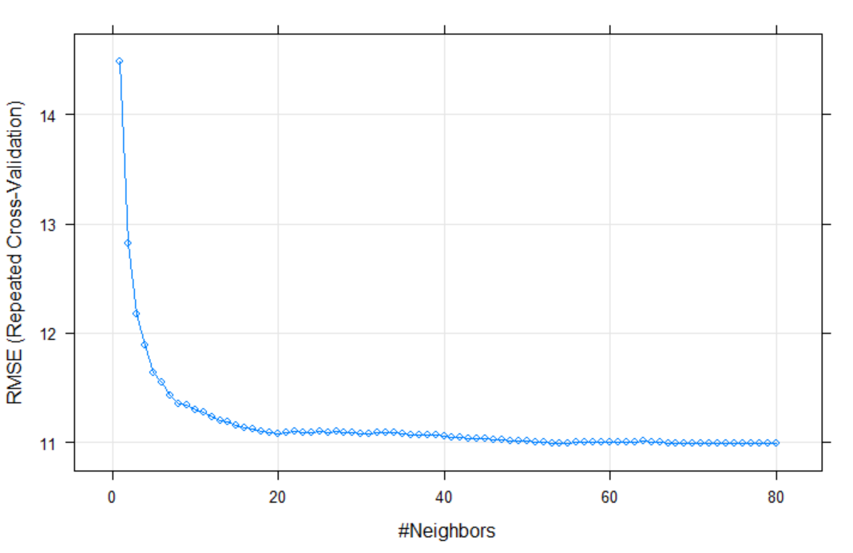
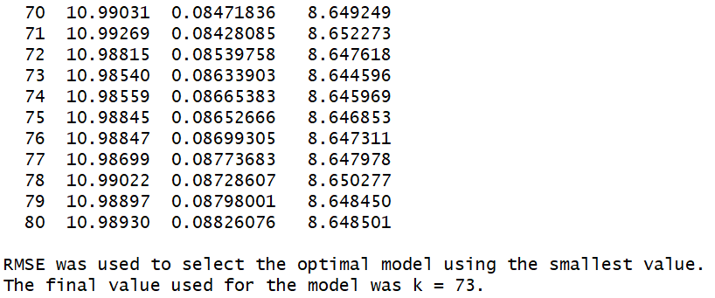
kNN Regression Steps
Fit training data with k-values from 1-80
Choose k-value with best RMSE
....

Slide 23
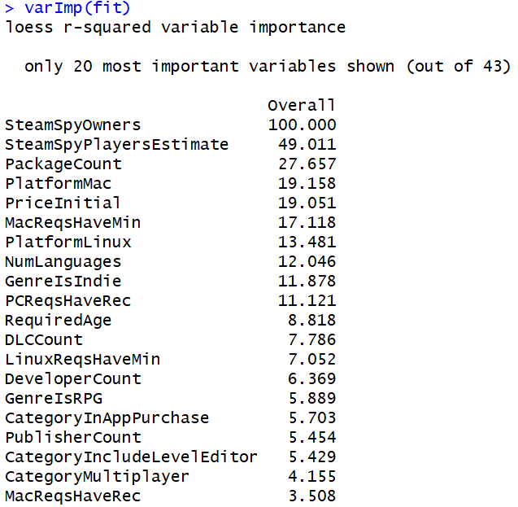
kNN Regression Steps
Predict metascore with validation dataset
Compare accuracy of prediction with validation dataset

Slide 24
Accuracy Measures
set.seed(413) | RMSE Root Mean Squared Error | MAE Mean Absolute Error
kNN Regression | 9.806265 | 7.862462

Slide 25
Regression Tree

Slide 26
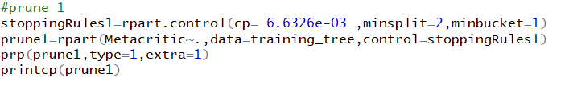
Regression Tree Steps
Automatic Prune
Unpruned
Manual Prune
Notes:
Too many splits can lead to overfitting> by increasing minisplit you reduce overfitting> so to find middle point we did
Talk about cp

Slide 27
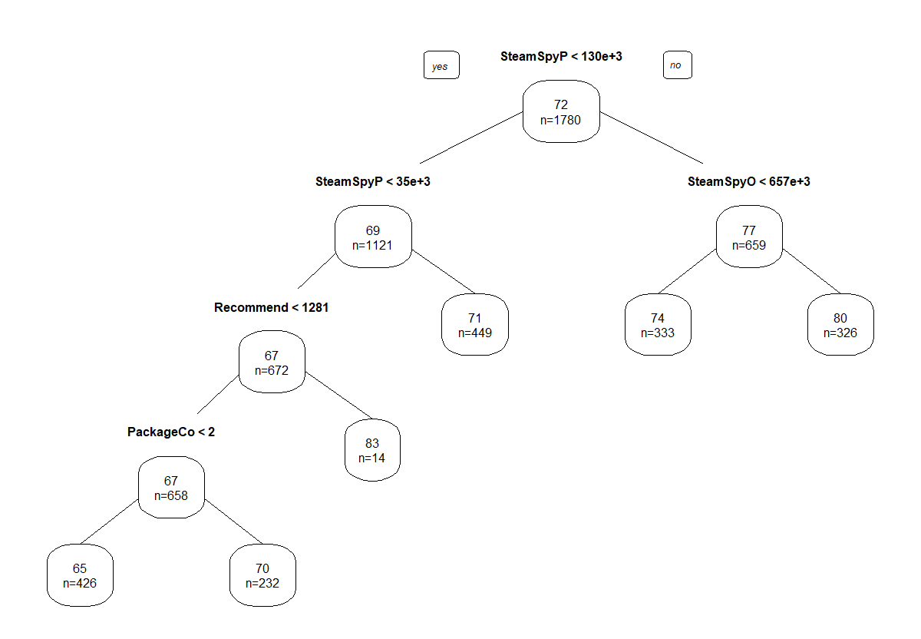
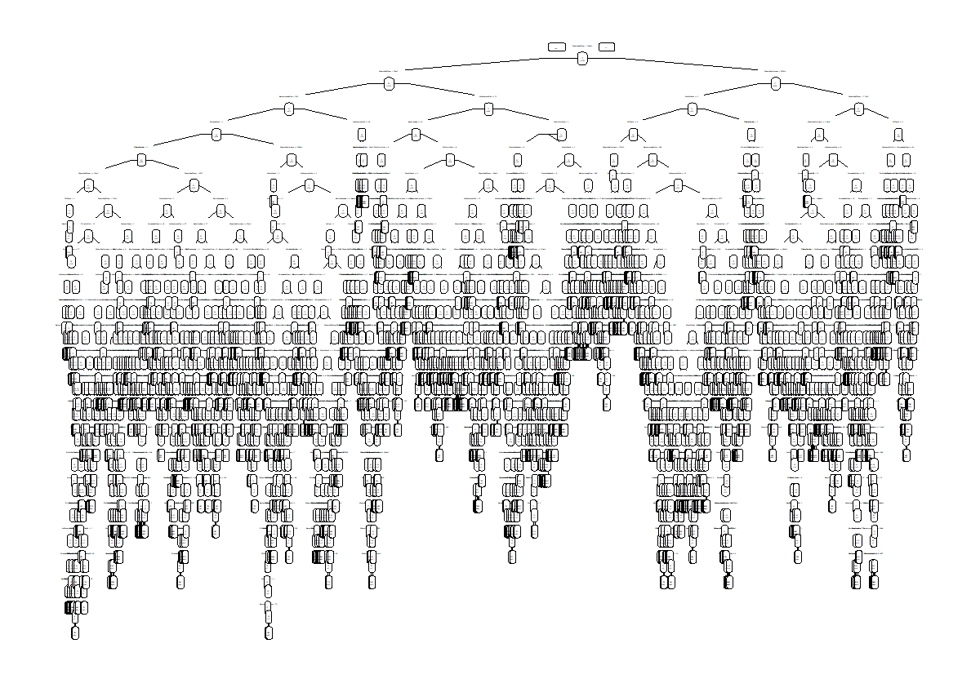
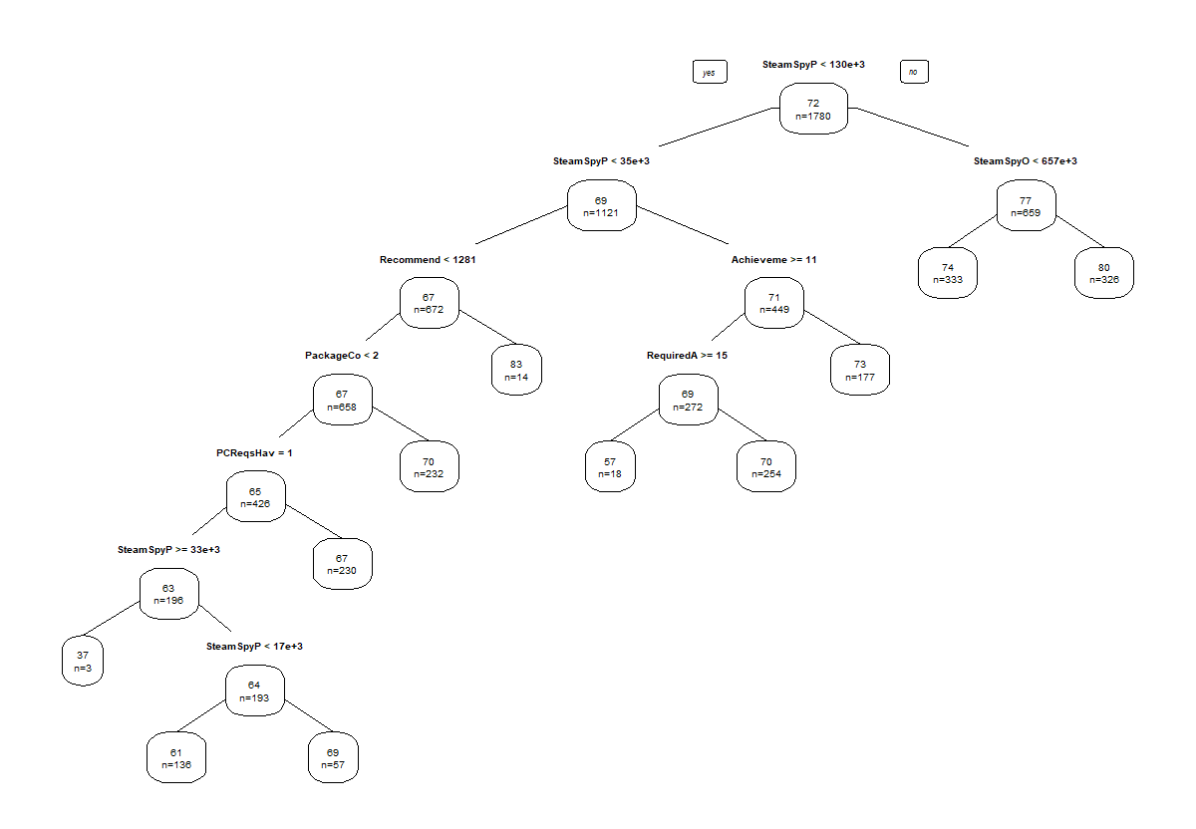
Regression Tree
Automatic
Un-pruned
Self-pruned

Slide 28
Accuracy Measures
 | RMSE Root Mean Squared Error | MAE Mean Absolute Error
Automatic Pruning | 9.482993 | 7.501056
Unpruned | 14.19547 | 10.75955
Manual Pruning | 9.797779 | 7.601913
Using a minsplit=2, minbucket=1

Slide 29

Min Split/ Min Bucket
Min split= 2
Min bucket= 1
Min split= 20
Min bucket= 10
Min split= 100
Min bucket= 50
Min split= 200
Min bucket= 100

Slide 30
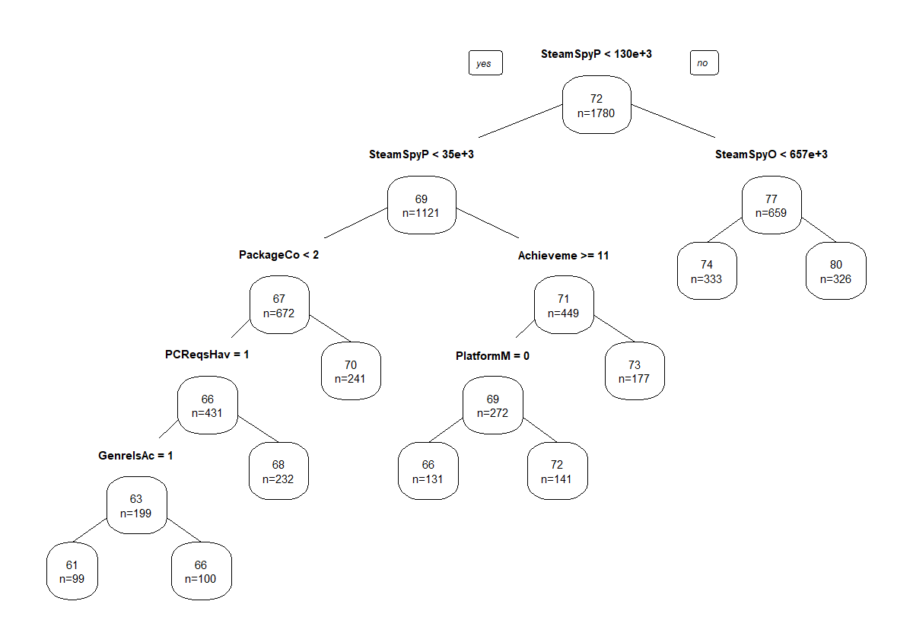
Manual Pruned Regression Tree
Most Important Variables:
SteamSpyPlayersEstimate
SteamSpyOwners
PackageCount
AchievementCount
PCReqsHaveRec
PlatformMac
GenreIsAction
Notes:
Steam Spy Players Estimate:
Steam Spy Owners> These two come after release of game

Slide 31
Comparing Results
set.seed(413) | Forward Selection Linear Regression | kNN Regression | Manual Regression Tree
RMSE | 9.878002 | 9.806265 | 9.474227

Slide 32
Method of Choice:
Manual Regression Tree
With Minbucket= 100, Minsplit= 50

Slide 33
Further Torturing
of the Data

Slide 34
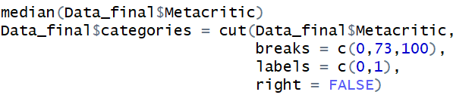
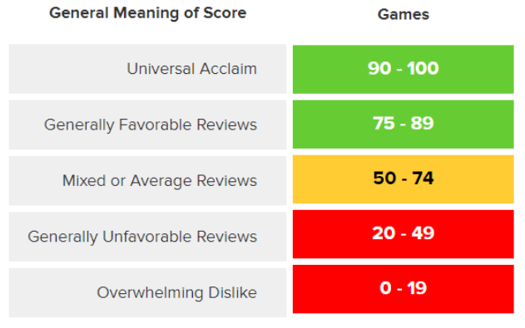
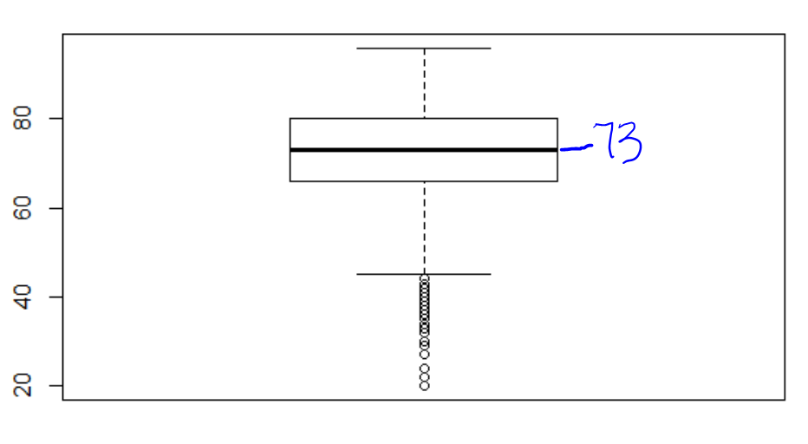
Classification
Threshold = 73
https://www.metacritic.com/about-metascores

Slide 35
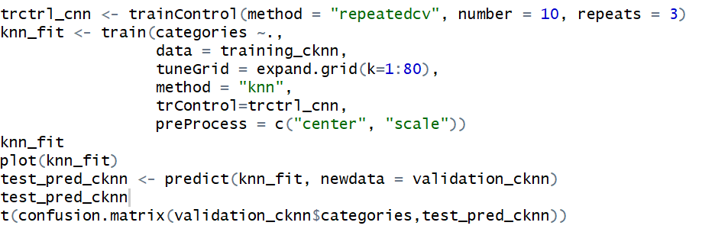
kNN Classification

Slide 36
Confusion Matrix
set.seed(12345) | Prediction
Observed | 0 | 1
0 | 102 | 124
1 | 74 | 145
 | kNN
Accuracy Rate | 0.5550562
Sensitivity | 0.6621005
Specificity | 0.4513274
AUC | 0.5567139

Slide 37
Logistic Classification
meta_logistic = glm(categories ~ ., training_class, family="binomial")
backward = step(meta_logistic,direction="backward")
forward = step(category_null,scope=list(upper=meta_logistic),direction="forward")
both = step(meta_logistic,direction="both")

Slide 38
Confusion Matrix
 | Base Logistic | Forward Logistic | Backward Logistic | Both Logistic
Accuracy Rate | 0.5932584 | 0.5730337 | 0.5955056 | 0.5955056
Sensitivity | 0.652968 | 0.6118721 | 0.6347032 | 0.6347032
Specificity | 0.5353982 | 0.5353982 | 0.5575221 | 0.5575221
AUC | 0.5941831 | 0.5736352 | 0.5961127 | 0.5961127
Set.seed (12345) | Prediction
Observed | 0 | 1
0 | 121 | 105
1 | 76 | 143

Slide 39
Positive |  | Negative
CategoryMultiplayer | 2.103e-01 | SteamSpyOwners | -3.293e-07
CategoryInAppPurchase | 1.072e+00 | PCReqsHaveRec | -2.832e-01
GenreIsRPG | 2.373e-01 | MovieCount | -5.644e-02
PriceInitial | 1.692e-02 | GenreIsSimulation | -4.401e-01
SteamSpyPlayersEstimate | 1.903e-06 | CategoryCoop | -4.707e-01
MacReqsHaveMin | 4.396e-01 | AchievementCount | -3.202e-03
CategoryIncludeLevelEditor | 4.382e-01 | GenreIsIndie | -2.156e-01
PackageCount | 1.835e-01 | GenreIsFreeToPlay | -8.974e-01
CategorySinglePlayer | 5.892e-01
CategoryMMO | 9.927e-01

Slide 40
Comparing Results
set.seed(12345) | kNN Classification | Logistic Classification
Accuracy Rate | 55.5% | 60.0%

Slide 41
Evaluation
Overall popularity (# of players, owners) → higher scores
*****Marketing/Brand Image is very important for a high Metascore*****
There are still additional variables that can help the score
Packages, Achievements, PC Spec Requirements, Platform is Mac
Genre: Action
Notes:
Popularity of game is most imp> players and owners ^ = higher meta score=
It makes sense that the higher number of players and owners result in higher metascores for games, as these scores are weighted average of reviews on the games.
Scores are primarily based on overall popularity of the game… not on other external benefits or categories

Slide 42
Lessons Learned

Slide 43
Lessons Learned
Think about the Bigger Picture
Teamwork also makes the data work
Understand the Dataset
Ensure that you know every variable and have a solid foundation of the data
Always perform your code by thinking of its effect on the whole file
We found ourselves most productive when together

Slide 44
Most Importantly...
“A good teacher can inspire hope, ignite the imagination, and instill a love of learning.” - Brad Henry
Thank You
Professor Zafari!

Slide 45
Thank you!
Any questions?

Slide 46
Data Dictionary
Appendix A1
Name | Description | Data Type
QueryName | The name of the game | Factor
RequiredAge | The age required in order to play the game | Integer
DemoCount | How many free demos were released to try the game | Integer
DeveloperCount | How many developers worked on the game | Integer
DLC Count | How many additional downloadable content were added for the game | Integer
Metacritic | A weighted average numeric score done by Metacritics – professional critics in the field | Integer
MovieCount | How many movies were released to showcase game | Integer
PackageCount | How many packages were offered with this game | Integer

Slide 47
Appendix A2
Name | Description | Data Type
RecommendationCount | How many users recommended the game to other users | Integer
PublisherCount | How many publishers published the game | Integer
ScreenshotCount | How many screenshots people take when playing the game | Integer
SteamSpyOwners | Total owners of the game – includes free weekend trials and other possibly spurious numbers | Integer
SteamSpyPlayersEstimate | Estimate of total number of people who have played the game since March 2009 (Published in 2016) | Integer
AchievementCount | Number of achievements a player can get for the game | Integer
ControllerSupport | Whether the game can be played with a controller | Factor
IsFree | Whether the game is free to play
Factor
FreeVerAvail | Whether there is a free version available | Factor

Slide 48
Appendix A3
Name | Description | Data Type
PurchaseAvail | Whether there is a purchasable version available to get the game | Factor
PlatformLinux | Whether the game can be played on Linux | Factor
PlatformMac | Whether the game can be played on Mac | Factor
PCReqsHaveRec | Whether there is a recommended spec to play the game on Windows | Factor
LinuxReqsHaveMin | Whether there is a minimum requirement to play the game on Linux | Factor
LinuxReqsHaveRec | Whether there is a recommended spec to play the game on Linux | Factor
MacReqsHaveMin | Whether there is a minimum requirement to play the game on Mac | Factor
MacReqsHaveRec | Whether there is a recommended spec to play the game on Mac | Factor
CategorySinglePlayer | Whether the game is single player | Factor
CategoryMultiplayer | Whether the game is multiplayer | Factor

Slide 49
Appendix A4
Name | Description | Data Type
CategoryCoop | Whether the game is cooperative ( Can players work together as teammates) | Factor
CategoryMMO | Whether the game is massively multiplayer online | Factor
CategoryInApPurchase | Whether the game has in-game purchases | Factor
CategoryIncludeLevelEditor | Whether the game is a level editor-styled game | Factor
CategoryVRSupport | Whether the game hosts VR support | Factor
GenreIsIndie | If the genre of the game is Indie | Factor
GenreIsAction | If the genre of the game is Action | Factor
GenreIsAdventure | If the genre of the game is Adventure | Factor
GenreIsCasual | If the genre of the game is Casual | Factor
GenreIsStrategy | If the genre of the game is Strategy | Factor

Slide 50
Appendix A3
Name | Description | Data Type
GenreIsRPG | If the genre of the game is RPG | Factor
GenreIsSimulation | If the genre of the game is Simulation | Factor
GenreIsFreeToPlay | If the genre of the game is Free To Play | Factor
GenreIsSports | If the genre of the game is Sports | Factor
GenreIsRacing | If the genre of the game is Racing | Factor
GenreIsMassivelyMultiplayer | If the genre of the game is Massively Multiplayer | Factor
PriceInitial | The initial price of the game upon release | Numeric
NumLanguages | Number of languages supported by the game | Numeric

Slide 51
5 Seeds: Regression Tree
Automatic Pruning | ME | RMSE | MAE | MPE | MAPE
Set.seed(1) | -0.7465511 | 11.13694 | 8.6073 | -4.321549 | 13.93217
Set.seed(212) | 0.03547142 | 12.10555 | 9.45788 | -3.076916 | 14.66531
Set.seed(123) | 0.331228 | 10.28418 | 7.943594 | -2.316857 | 12.50561
Set.seed(413) | 0.3035671 | 9.482993 | 7.501056 | -1.408526 | 11.02485
Set.seed(1234) | -0.592503 | 10.5475 | 8.085755 | -3.527331 | 12.78858

Slide 52
5 Seeds: Regression Tree
Unpruned | ME | RMSE | MAE | MPE | MAPE
Set.seed(1) | 0.5280899 | 13.84854 | 11.07191 | -1.691374 | 16.81575
Set.seed(212) | -0.6426966 | 13.39814 | 10.34607 | -3.24976 | 16.05028
Set.seed(123) | -0.6449438 | 13.28351 | 10.1191 | -2.987217 | 15.39325
Set.seed(413) | -1.020225 | 14.19547 | 10.75955 | -5.320908 | 17.70835
Set.seed(1234) | -0.08539326 | 13.03582 | 10.14382 | -2.402584 | 15.42945

Slide 53
5 Seeds: Regression Tree
Manual Pruning | ME | RMSE | MAE | MPE | MAPE
1 cp=6.6326e-03 | 0.8322644 | 11.11379 | 8.574401 | 1.082698 | 12.02646
212 cp=7.6838e-03 | -0.05661751 | 10.62791 | 8.240208 | -0.2635683 | 11.67324
123 cp=1.1431e-02 | -0.3514711 | 10.60646 | 8.189484 | -0.4372384 | 11.51917
413 cp=6.1910e-03 | -0.04574363 | 9.474227 | 7.440955 | -0.2205658 | 10.37508
1234 cp= 8.1875e-03 | 0.455884 | 10.59614 | 8.109552 | 0.4456527 | 11.3952

